Slide 1
HELLO
everyone

Slide 2

PROJECT: PEEL RESCUE
By: Pallavi Limaye & Nitu Balwani

Slide 3

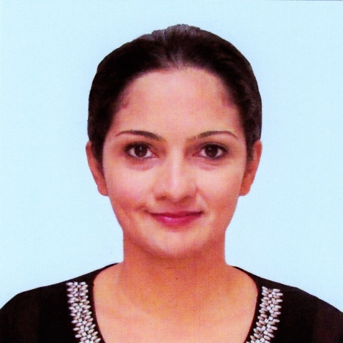
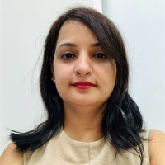
Our Team
Pallavi Limaye
Electronics Engineering
C
b
c
U
G
Nitu Balwani
Master Of Pharmacy
C
b
c
U
G

Slide 4

Contribution In Application
Pallavi
Nitu
Development
Development
Server, Rest API, API client and Buyer part
40%
d
.
Seller and Admin part, Database and Presentation
.
60%
QA
f
QA
Client application for testing
REST API
50%
.
Covers Application DB Test Cases
.
50%

Slide 5
PEEL RESCUE
Background

Slide 6

r
Fruit Juice Shop
What's Happening
Peel, Cut, Grind, Repeat
First Step
What Can Be Done
Peel, Cut, Grind, Reuse, Recycle, Reduce, Repeat
(ECHO NEA 3R’s)
Peel The Fresh Fruit
Second Step
Y
b
Cut and Grind Fresh Fruit
Step 05
Reuse
Step 06
Recycle
Third Step
Serve Fresh Fruit to Customer = Happy Buyer + Happy Seller
Result 01
Health Benefits
Result 02
Environment Friendly
r
L
Fourth Step
Throw Peel =
Unhappy Environment + Wasted Nutrients

Slide 7
PEEL RESCUE
Need

Slide 8
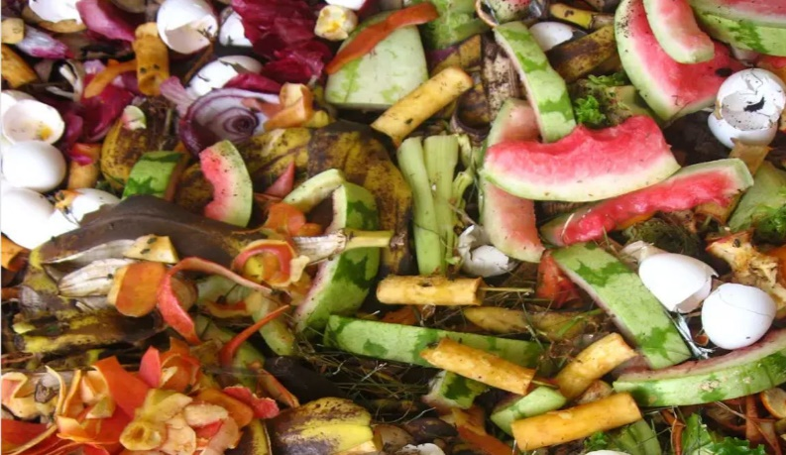
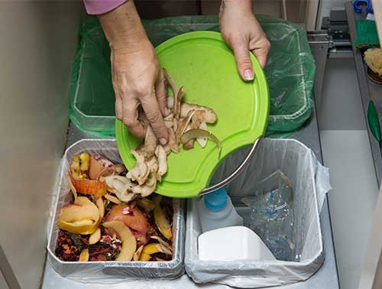
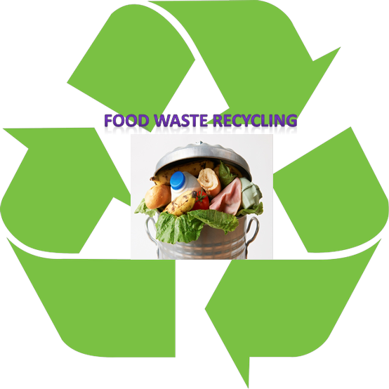
ANNUAL REPORT 2019
NEA Singapore
Amount Of Food Waste Generated
Food Waste Generated
744 K Tons Food Waste
Food Waste Disposed
607 K Tons Food Disposed
Food Recycle = 136 Tons
18% Recycle

Slide 9
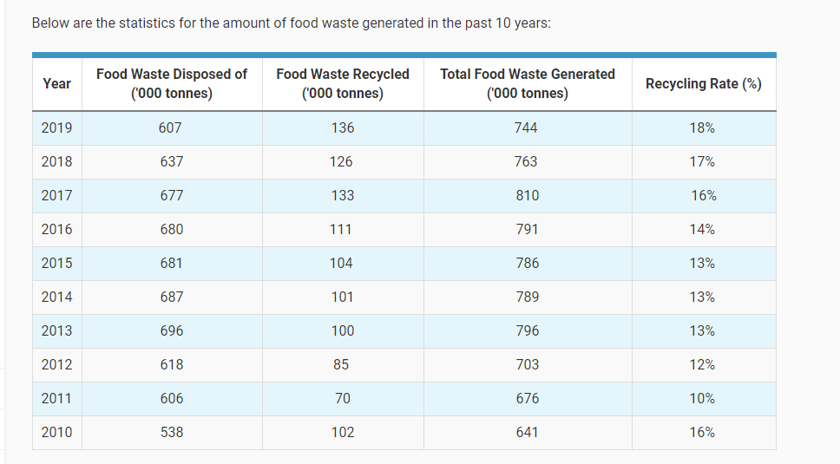
Statistics:

Slide 10
PEEL RESCUE
Benefits of Fruit Peel

Slide 11
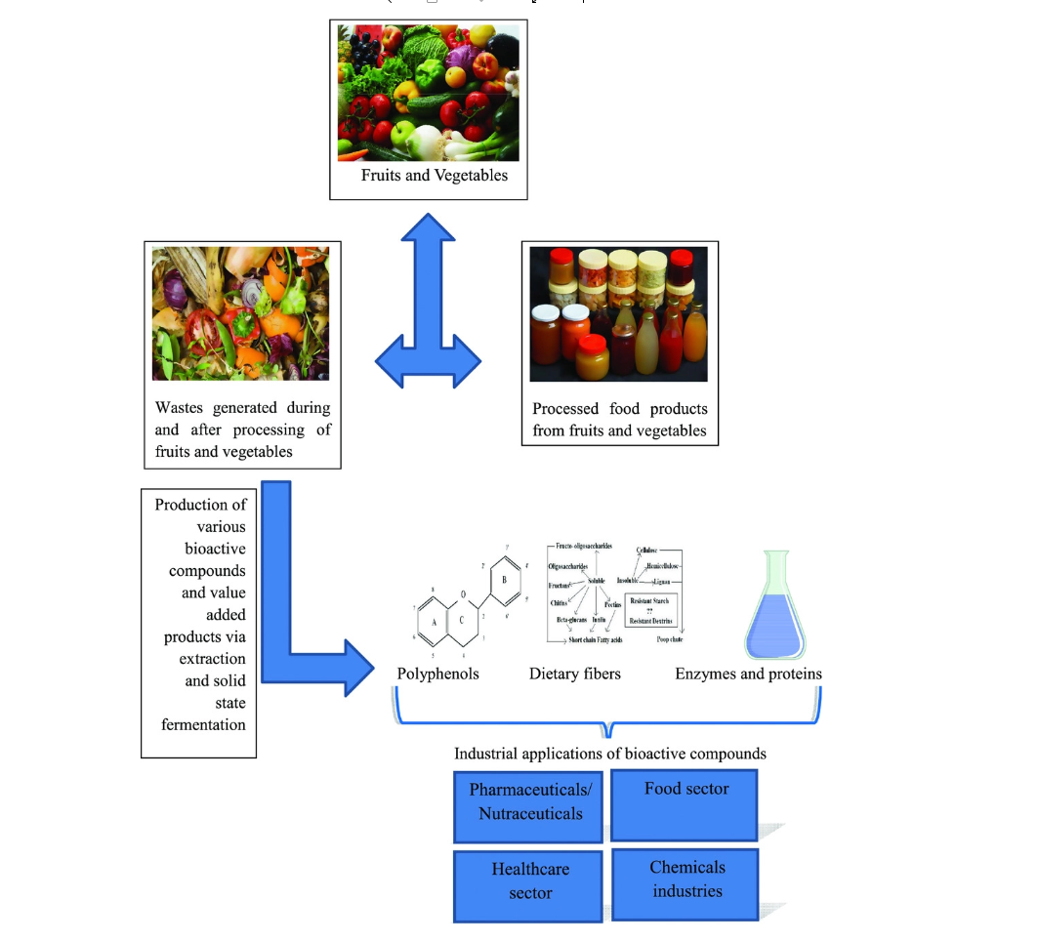

Slide 12
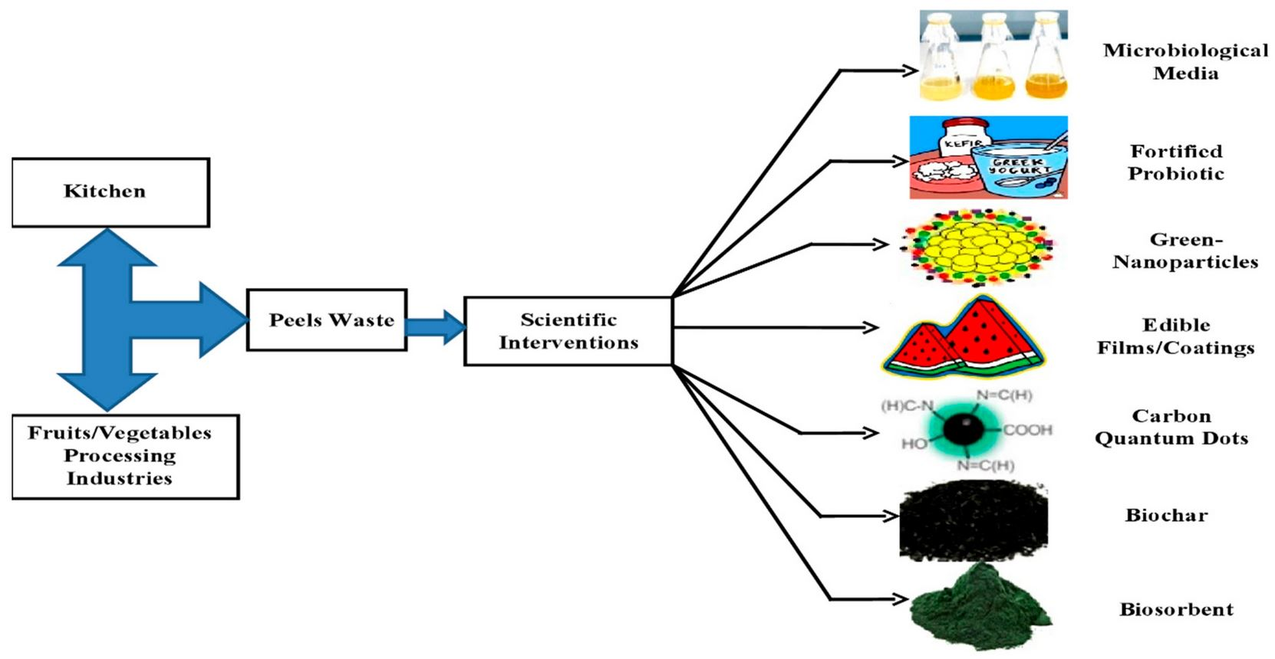
Companies

Slide 13
PEEL RESCUE
Stakeholders

Slide 14
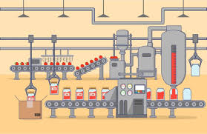
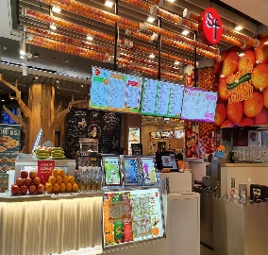
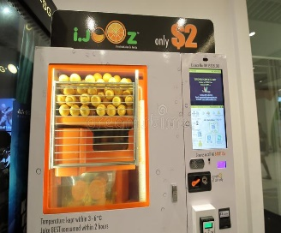


STAKEHOLDERS
Juice shop
C
Companies
Fruit peels Processing Industry
Companies
C
NEA
We
Peel Rescue
f
f

Slide 15
PEEL RESCUE
Productive Output

Slide 16
We’re always looking for online stores
S
B
Sell your product
Buy the product
Juice Shop Owner can list their products(fruit peel) along with cost and quantity
Prospective buyer(Industries) can browse through products and buy.
Best Service, Right Time, Right People

Slide 17
PEEL RESCUE
Tools

Slide 18


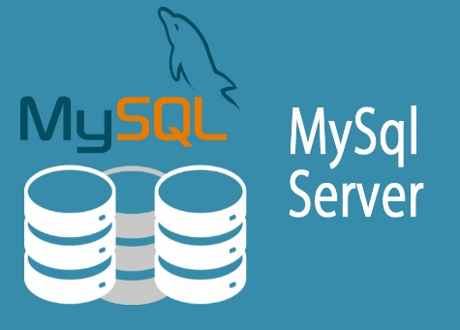

Tools
g
i
f
d
K

Slide 19
PEEL RESCUE
Work Flow

Slide 20
Peel Rescue system
User Information
Database
JSON Interface
Rest API
On Web Server
Application on Web Server
Go Templates to Browser for User interface
Seller Items Database

Slide 21






Web Server localhost:5000
Database :Docker container for storing User Information
SELECT()
INSERT()
UPDATE()
DELETE()
HTTPS
GET
POST
PUT
DELETE
SELECT()
INSERT()
UPDATE()
DELETE()
JSON
CREATE
REVIEW
UPDATE
DELETE
Database : Docker container for storing Seller Items Information
Web Server localhost:5221
HTML interface
Go Templates
Web Application
HTML interface
Go Templates
Buyer : HTML Browser
Add/update/delete items to/from cart from all sellers
Seller : HTML Browser
Add/Update/Delete items

Slide 22
Detailed Internal Structure

Slide 23
c
Step One
Seller Signs up
Step Seven
Buyer Logs out
Step Two
Seller Adds Items
Step Six
Buyer Receives email notifications
Buyer/Seller Interface
Step Three
Seller Updates Items
Step Five
Buyer Checks out
Step Four
Seller Deletes Items
Buyer/Seller Features
Step Four
Buyer Adds/Updates/Deletes from Cart
Step Five
Seller Views Profile
Step Three
Buyer Searches for items
Step Six
Seller Receives email notifications
Peel Rescue
Step Two
Buyer Views all items
Step Seven
Seller Logs out
Step One
Buyer Signs up

Slide 24
Delivery

Slide 25
PEEL RESCUE
Project Timeline

Slide 26

Peel Rescue Timeline
4
3
2
1
90%
100%
30%
60%
Week 1
Brainstorming
Database
Templates
Signup/Login
Week 2
Rest API
Items Details
Buyer/seller
Crud
Week 3
Test Cases
Admin Notifications
CICD
Testing/Debugging
Presentation

Slide 27
PEEL RESCUE
Future Aspects

Slide 28
Limitations/Enhancements

Slide 29
PEEL RESCUE
Demo

Slide 30
Thank You
for watching our presentaion

